Slide 1

Student Interest System
Hassan Ahmed Bcsf20m049

Slide 2

Technologies Used:
Html
CSS
JavaScript
JSX
React

Slide 3
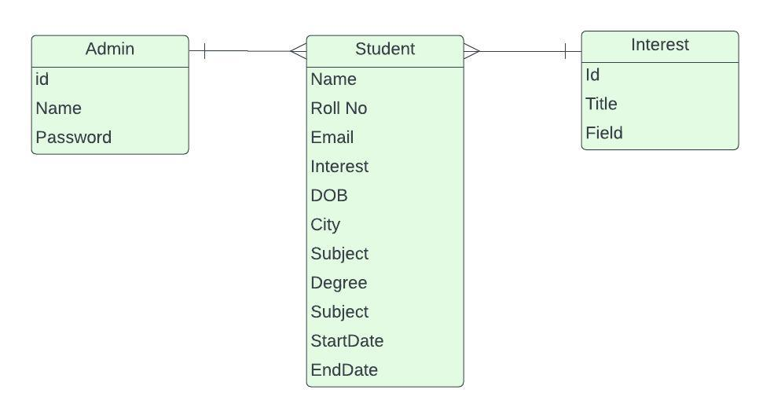
ERD Entity Relation Diagram:
Html
CSS
JavaScript
JSX
React

Slide 4

Navbar
The Landing Page of the System is Dashboard which has two Buttons to navigate.
Student Register
Student List

Slide 5
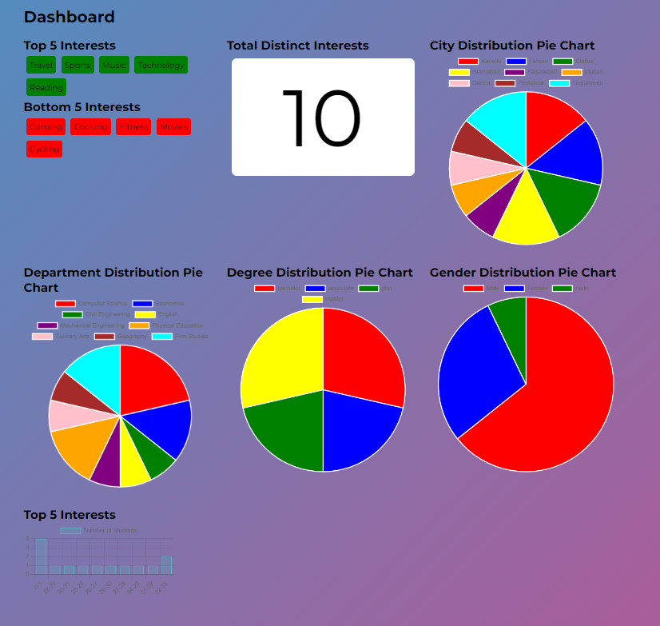
Dashboard
The Student Will be able to see
only this
Top & Bottom Interests
Total Instinct Interest
City Distribution Pie Chart
Department Distribution Pie Chart
Degree Distribution Pie Chart
Gender Distribution Pie Chart
Top 5 Interests

Slide 6
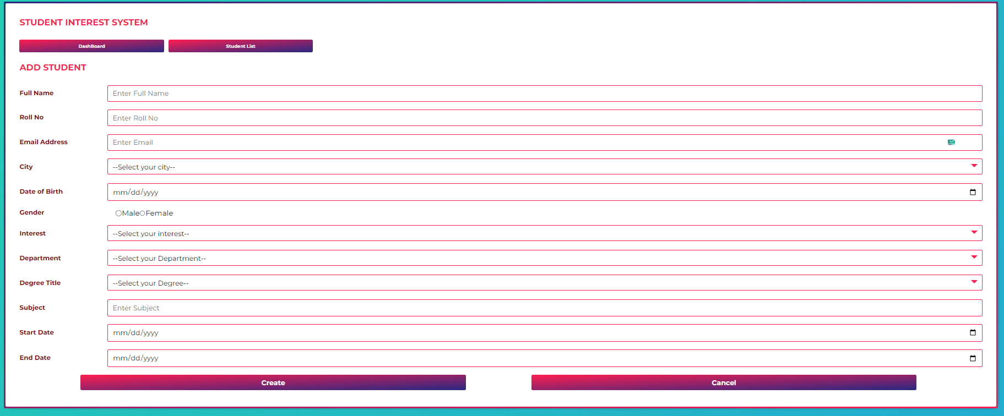
Add Student Form:
In this admin can add the Data of student

Slide 7
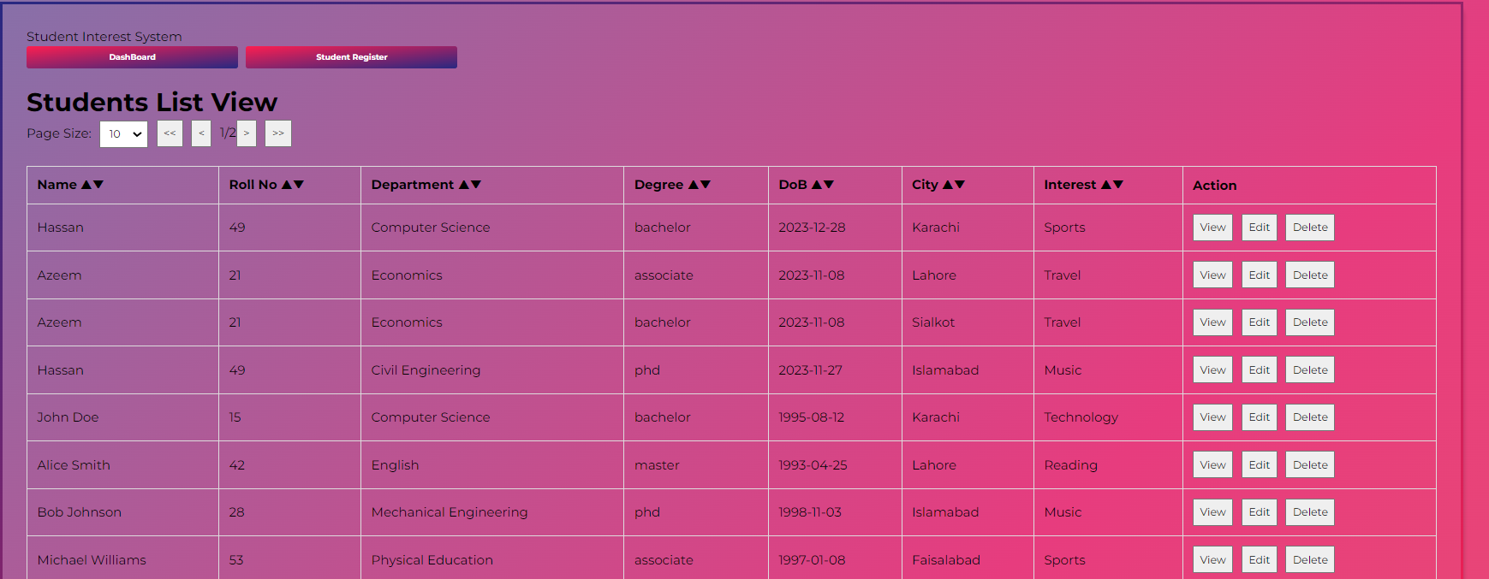
Student List:
In this Students List will Be Shown (with CRUD Operations
VIEW , EDIT, DELETE

Slide 8
Student List:
Page size Determine the records you want to show on a page.
On clicking Header’s Column it will sort the List Accordingly.

Slide 9
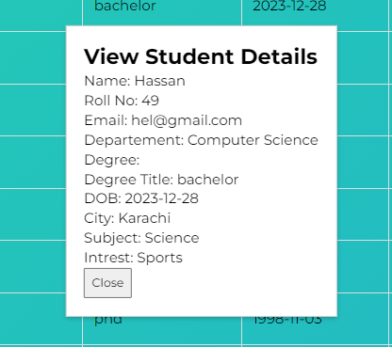
Student List:
VIEW
On Clicking VIEW this Dialogue Box Will Appear.
It Contains All the Data you collected from the Student Form.

Slide 10
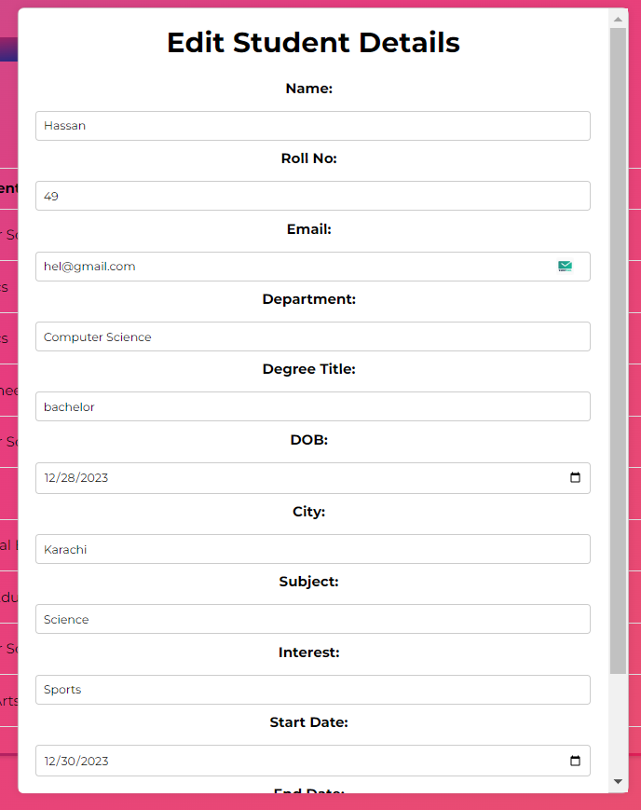
Student List:
EDIT
On Clicking VIEW this Dialogue Box Will Appear.
It Contains All the Data you collected from the Student Form.

Slide 11
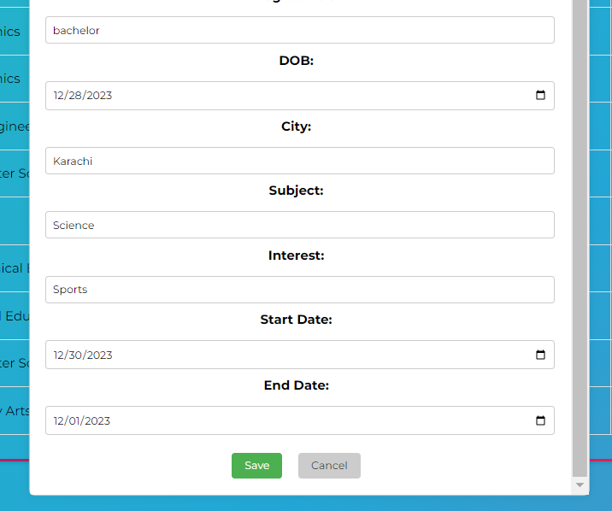
Student List:
EDIT
On Pressing Save it
Will Update the Student
You Edited and change the Dashboard Changes
Accordingly

Slide 12
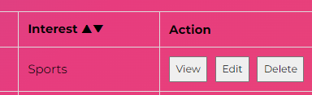
Student List:
DELETE
On Pressing Delete it
Will Student the Student
You Selected and change the Dashboard Changes
Accordingly

Slide 13


Thank you
Hassan Ahmed

